Slide 1


Сoenzyme Q10
100 mg
Vital energy and active longevity

Slide 2


The ubiquitous
quinone
Coenzyme Q10 is a vitamin-like fat-soluble substance that is present in most living cells of humans, plants, fungi, and microorganisms. Because it is found literally everywhere in the body, it is also known as ubiquinone (from the Greek “ubiquitous quinone”).
Coenzyme Q10
Notes:
Coenzyme Q10 is a small hydrophobic molecule mainly found in the mitochondria of cells, where it is dissolved in the lipid bilayer.

Slide 3
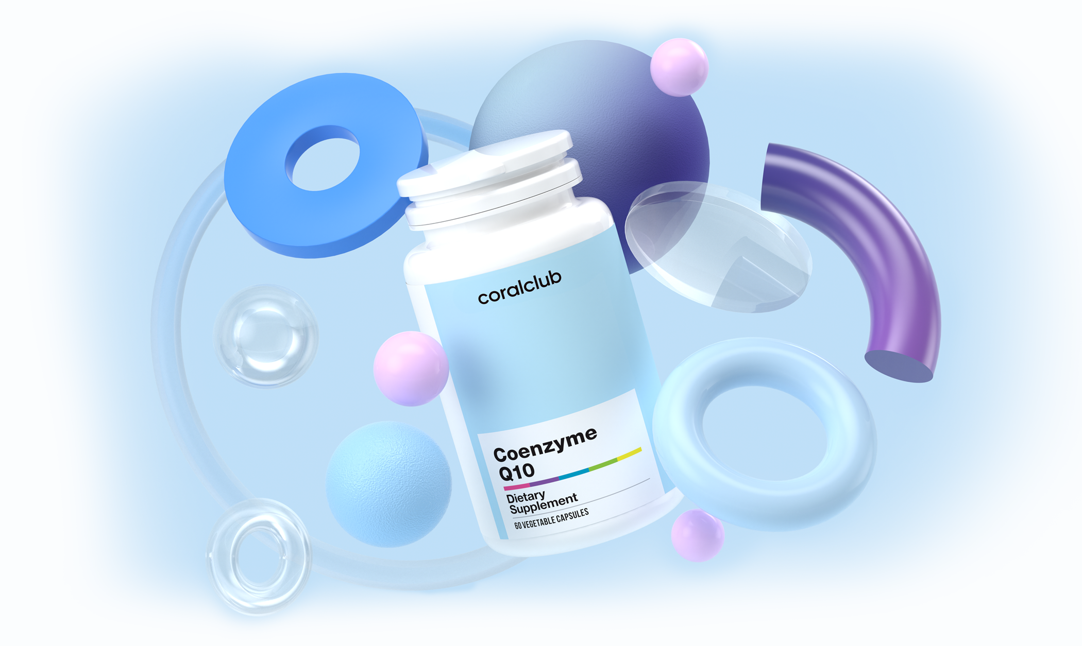
Why does the body need
coenzyme Q10?
01
02
Participates in
energy production
Acts as a
powerful antioxidant
Coenzyme Q10 participates in the synthesis of the energy molecule ATP (adenosine triphosphate) and thus is involved in the production of 95% of the body's energy.*
Coenzyme Q10 protects cells from damage by free radicals and prevents oxidation of other powerful antioxidants - vitamins E and C.**
Coenzyme Q10
Notes:
* Coenzyme Q10 participates in the production of energy in every cell in the body. It is a vital participant in the chain of metabolic chemical reactions that generate energy within cells and is involved in the production of 95% of the body's energy. Without the participation of coenzyme Q10, cells cannot synthesize ATP (adenosine triphosphate), which is the main source of energy for the body. Therefore, organs and tissues with high energy demand, such as the heart, brain, liver, lungs, kidneys, and pancreas, are especially susceptible to a coenzyme Q10 deficiency.
** It acts as an antioxidant. Coenzyme Q10 is the only fat-soluble antioxidant capable of being independently synthesized in humans and animals. It is also constantly regenerated from oxidation, thus restoring its antioxidant capability. Coenzyme Q10 has a direct antioxidant effect in that it traps free radicals and prevents oxidation of cell membranes (ensuring their stability), thus protecting DNA from damage by free radicals. It also has an indirect antioxidant effect in that it prevents the oxidation of vitamins E and C, which are also potent antioxidants.

Slide 4




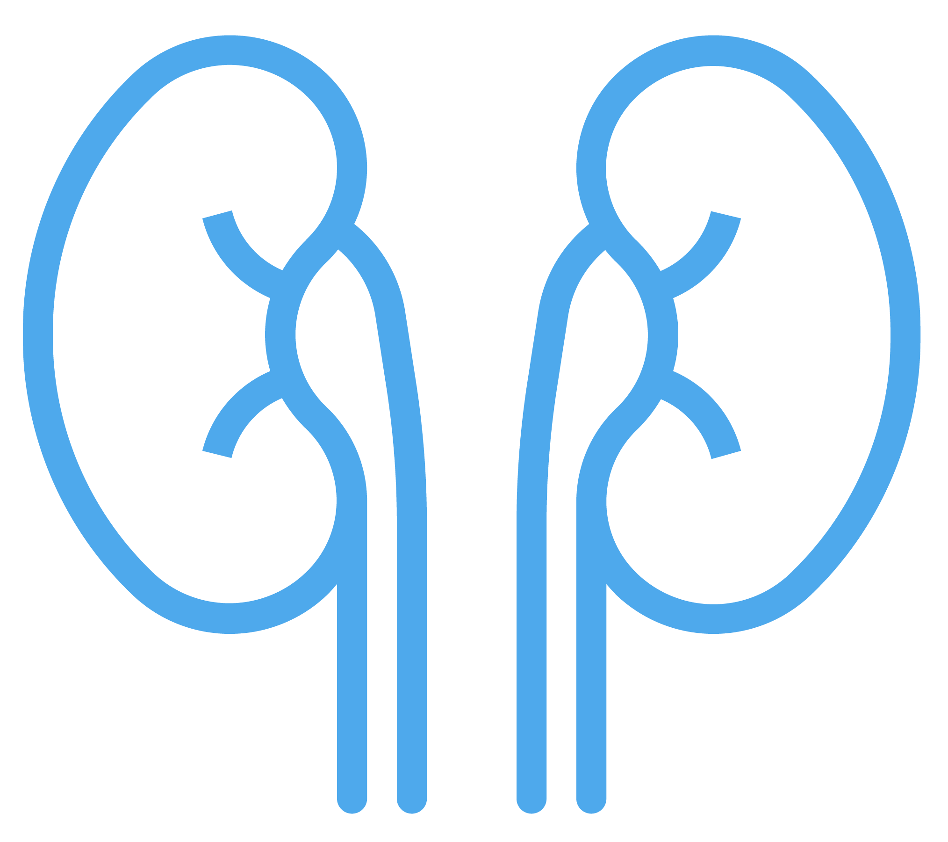

Most of the body’s coenzyme Q10 is found in the cells of those bodily organs with the highest energy demand:
Heart
Therefore, these organs are especially susceptible to a coenzyme Q10 deficiency, as it is vital for their normal functioning.
Liver
Kidneys
Pancreas
Coenzyme Q10

Slide 5
Synthesis in the body
В2
Coenzyme Q10 has the unique ability to be both independently synthesized and regenerated in the body.
В3
В5
This complex, multi-stage process takes place in the body’s liver cells* with the participation of vitamins B2, B3, B6, B12, and C, as well as folic acid, pantothenic acid, and a number of trace elements.
В6
В9
However, the process of coenzyme Q10 synthesis slows with age.
В12
С
Coenzyme Q10
Notes:
British biochemist Peter Mitchell developed the theory explaining Coenzyme Q10’s role in helping cells convert the energy of nutrients into cell energy. He went on to win the Nobel Prize in Chemistry in 1978 for his research.
* The chemical basis for this is mevalonic acid and derivatives of the amino acids tyrosine and phenylalanine.

Slide 6






What slows coenzyme Q10 synthesis?
Age*
Vitamin and trace element deficiencies
Abnormal cholesterol levels and
liver dysfunction
High levels of physical or
mental stress
Taking cholesterol
medication (statins)
Alcohol and smoking
Coenzyme Q10
Notes:
* Coenzyme Q10 is constantly being synthesized in the body. However, after age 30, this process begins to slow down, leading to lowered levels and potentially a deficit. By age 40, coenzyme Q10 synthesis in the body drops to 70%. By age 60, this amount decreases to 50%.
Barcelos, I. P., & Haas, R. H. (2019). CoQ10 and Aging. Biology, 8(2), 28. https://doi.org/10.3390/biology8020028

Slide 7




How does age affect coenzyme Q10 synthesis?
Coenzyme Q10 synthesis in the body:
100%
100%
95.3%
Liver
83%
72.6%
68.2%
65.3%
Lungs
51.7%
42.9%
Kidneys
Heart
Age 20
Age 40
Age 80
Coenzyme Q10

Slide 8





Symptoms of a coenzyme Q10 deficiency
Cardiovascular dysfunction
Metabolic disorder*
Weakened immune system
Blurred vision and
gum disease
Increased risk of developing age-related pathologies of the central nervous system
Addressing a coenzyme Q10 deficiency is not easy, as food only contains trace amounts of it!**
Coenzyme Q10
Notes:
* A metabolic disorder is a disorder that negatively alters the body's processing and distribution of macronutrients such as proteins, fats, and carbohydrates. Metabolic disorders can happen when abnormal chemical reactions in the body alter the normal metabolic process.
** Q10 is found in trace amounts in foods such as fatty fish (sardines, mackerel, salmon, and herring), organ meats (sometimes referred to as “offal”), poultry, beef, legumes, nuts, and to a lesser extent in vegetables (cabbage, carrots, onions, potatoes, spinach, etc.).

Slide 9
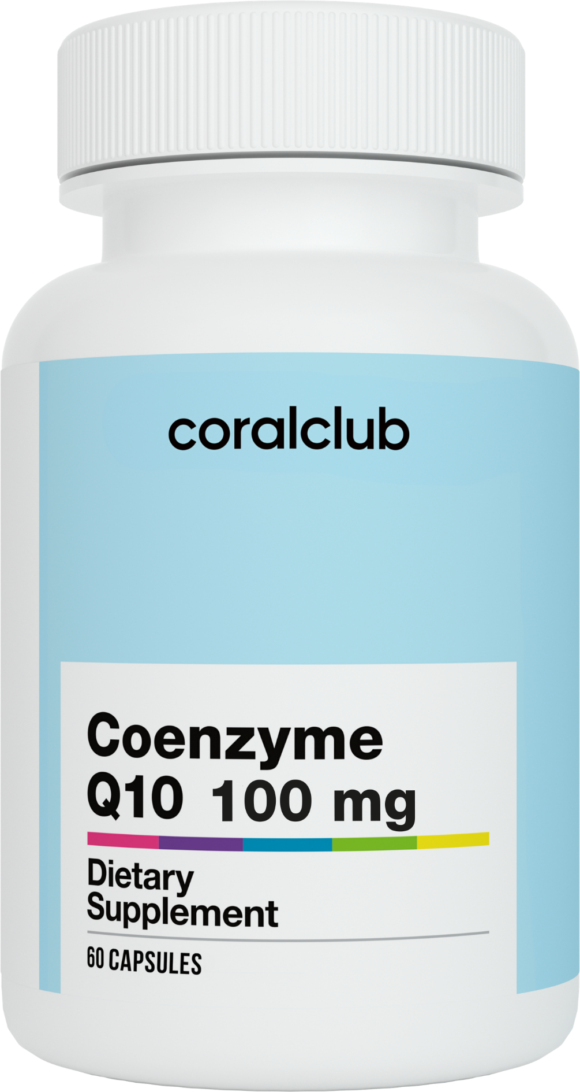
Сoenzyme Q10 100 mg
Helps to address coenzyme Q10 deficiency
(60 capsules)
Each capsule contains:
Coenzyme Q10
100 mg
Coenzyme Q10

Slide 10





Coenzyme Q10 100 mg
Fights against
skin aging
Provides vital energy to the cardiovascular, muscular, and nervous systems
Strengthens the
immune system
Helps to more easily cope with increased physical and mental stress
Prolongs active longevity
Coenzyme Q10

Slide 11
References
Kalén, A., Appelkvist, E. L., & Dallner, G. (1989). Age-related changes in the lipid compositions of rat and human tissues. Lipids, 24(7), 579–584. https://doi.org/10.1007/BF02535072
Medvedev, O.S. (2012). Slowing down the aging process: focusing on coenzyme q10. Difficult Patient, 10 (4), 50-60.
Mortensen S. A. (1993). Perspectives on therapy of cardiovascular diseases with coenzyme Q10 (ubiquinone). The Clinical investigator, 71(8 Suppl), S116–S123. https://doi.org/10.1007/BF00226851
Klyuchnikov S.O., & Gnetneva E.S. (2008). Ubiquinone (coenzyme Q10): theory and clinical practice. Pediatrics. Journal of G. N. Speransky, 87 (3), 20.
Hernández-Camacho JD, Bernier M, López-Lluch G, Navas P. Coenzyme Q₁₀ Supplementation in Aging and Disease. Front Physiol. 2018 Feb 5;9:44. doi: 10.3389/fphys.2018.00044. PMID: 29459830; PMCID: PMC5807419.
Barcelos, I. P., & Haas, R. H. (2019). CoQ10 and Aging. Biology, 8(2), 28. https://doi.org/10.3390/biology8020028
Coenzyme Q10

Slide 12

COENZYME Q10 100 mg

